Slide 1
Palette Picker Update
Simon Stockton, Victoria Senn, Eric Brewer, Lily Thompson

Slide 2
Introduction
During the first few months of developing the Palette Picker application we have overcome some obstacles and realized we are going to have to do some things a little differently than we originally expected
We had anticipated things changing in the beginning so, this has not caused us much worry
Our team has learned a lot and things have become a lot clearer since the start.
Our accomplishments have our hopes high for the things we have yet to accomplish

Slide 3
Outline
Changes and deviations
Accomplished Items
Complete and Partially Complete
Items that still need to be implemented
Unresolved Issues
Design Diagram
Conclusion

Slide 4
Changes and Deviations
Cut:
feature for recommending complimentary or adjacent colors
If short on time, could cut:
friend activity on the user’s home page
filtering of search results

Slide 5
Accomplished Items - Database
Complete:
Database Itself (tables and relations)
Main functions for getting and sending data to DB
Some functions using SQL to get, send, or verify info
Partially Complete:
Functions for interaction between UI and DB
Sending DB info between pages

Slide 6
Partially Complete - Friends
Complete:
DB function to get a user’s friends
Incomplete:
Implementation of the function in the UI
User’s friends on profile page
Friend activity on home page

Slide 7
Partially Complete- Palette from an Image
Complete:
Pulling an image from the users computer
Creating a simple palette from an image
Incomplete:
Connecting these two parts
Improving palette algorithm

Slide 8
Need to be Implemented- Manual Palette Creation
Mostly will be implemented while implementing Palette from an image
Pulling colors from a grid rather than a picture
Hue Slider

Slide 9
Need to be Implemented - Database
DB functions relating to the search feature
Specific SQL Functions
Connecting the php connection file to the UI
Functions in UI that will use DB info
Password encryption

Slide 10
Need to be Implemented - Search Bar
UI for search bar on most pages
Getting DB info for search page
Filtering search results
By color, creator, or palette name

Slide 11
Need to be Implemented - User Interface
Top Navigation
Alerts drop down
Search feature connection
Link to user profile
User Profile
Add a friend pop-up
Link to friend profile
Link to saved palettes

Slide 12
Need to be Implemented - User Interface
Logged In Homepage
Friend activity
Palette creator pop-up
Palette Info
Color representation from database
Palette information
Link to creator
Ability to save to Saved Palettes

Slide 13
Need to be Implemented - User Interface
Aesthetic/Functionality
Make the Top Navigation more appealing by using icons
Create a expandable view for Saved Palettes versus a whole separate page
Palette Info could utilize icons for save/saved and display information in a better layout

Slide 14
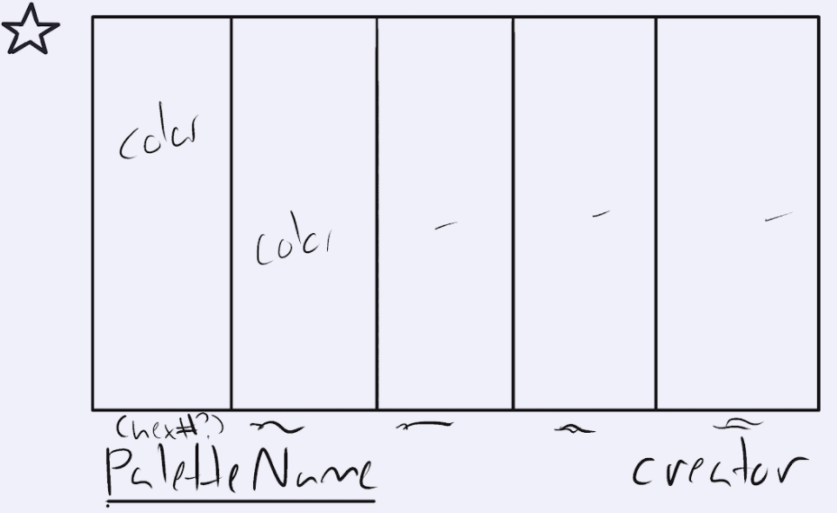

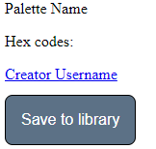

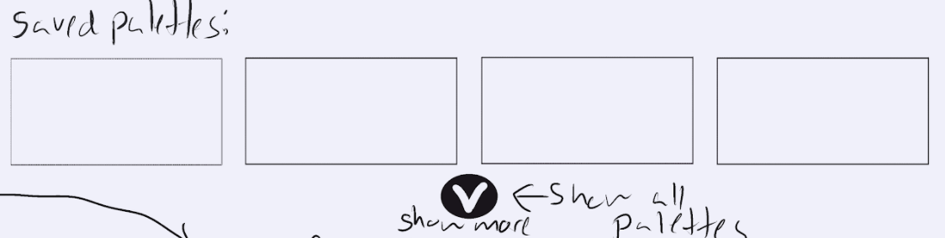
Mock-up Comparison - User Interface

Slide 15
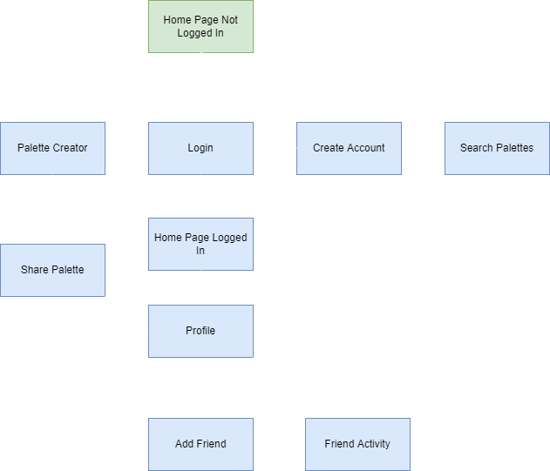
Design Diagram

Slide 16
Conclusion
Though we have had to make some changes to the Palette Picker, we are confident that these changes are for the best
What we have learned up to this point have made us confident that things will continue to go smoothly through the finish line
Some things are still subject to change
Connecting all of our components to each other and the database is what we will spend most of our time focusing on from here on out
This has been a great learning experience for our team

